Slide 1
Distributed Representations of Words and Phrases and their Compositionality
By : Pranav Deep. I

Slide 2
Contents
What does the paper talk about?
Skip - gram model : Intuition, Architecture, Mathematics, Need
Softmax
Avoiding Softmax
Hierarchical Softmax
NCE
Negative Sampling
Subsampling
Results

Slide 3
The essence of the paper
Extension of the skip-gram model
Improvements in : Quality of Vectors, Training Speed
By Subsampling of the frequent words also learn more regular word representations
Simple alternative to the Hierarchical Softmax called Negative Sampling
Comparison of Hierarchical Softmax, NCE, Negative sampling with an without subsampling
Presented a simple method for finding phrases in text

Slide 4
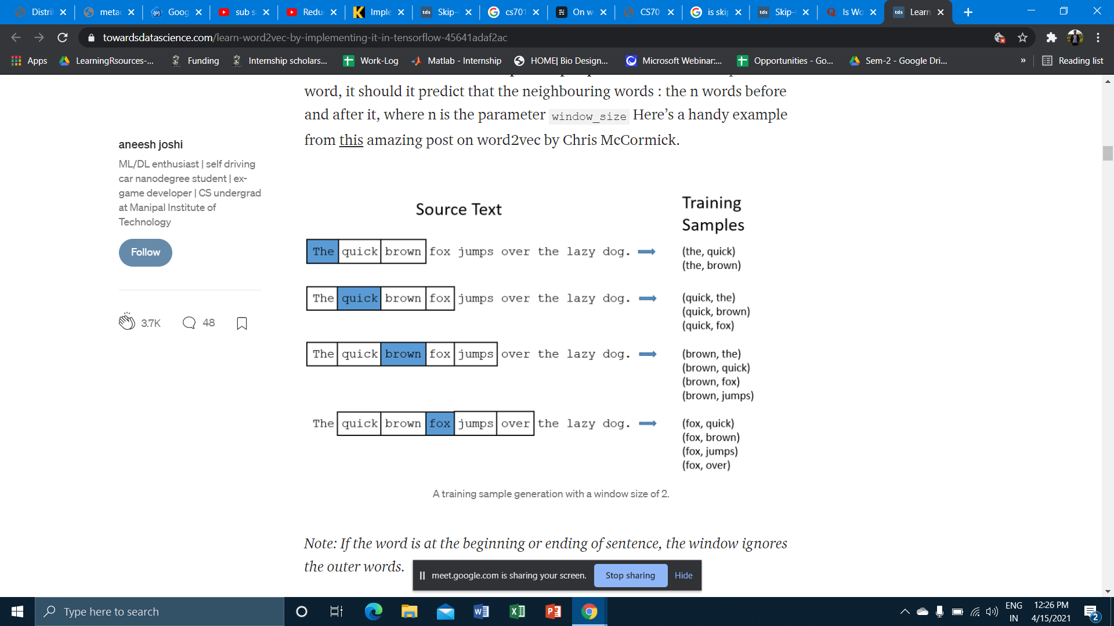
Skip Gram Model
Tries to predict the context(surrounding) words, given a target word.
Efficient method for learning high quality of vectors
No dense matrix multiplications, therefore - efficient Training
Kind of self supervised learning
Notes:
Reverse of CBOW model

Slide 5
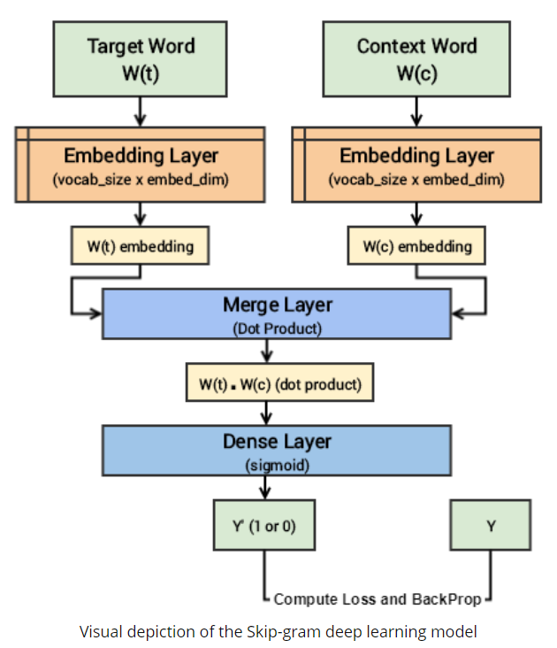
Skip Gram Architecture

Slide 6
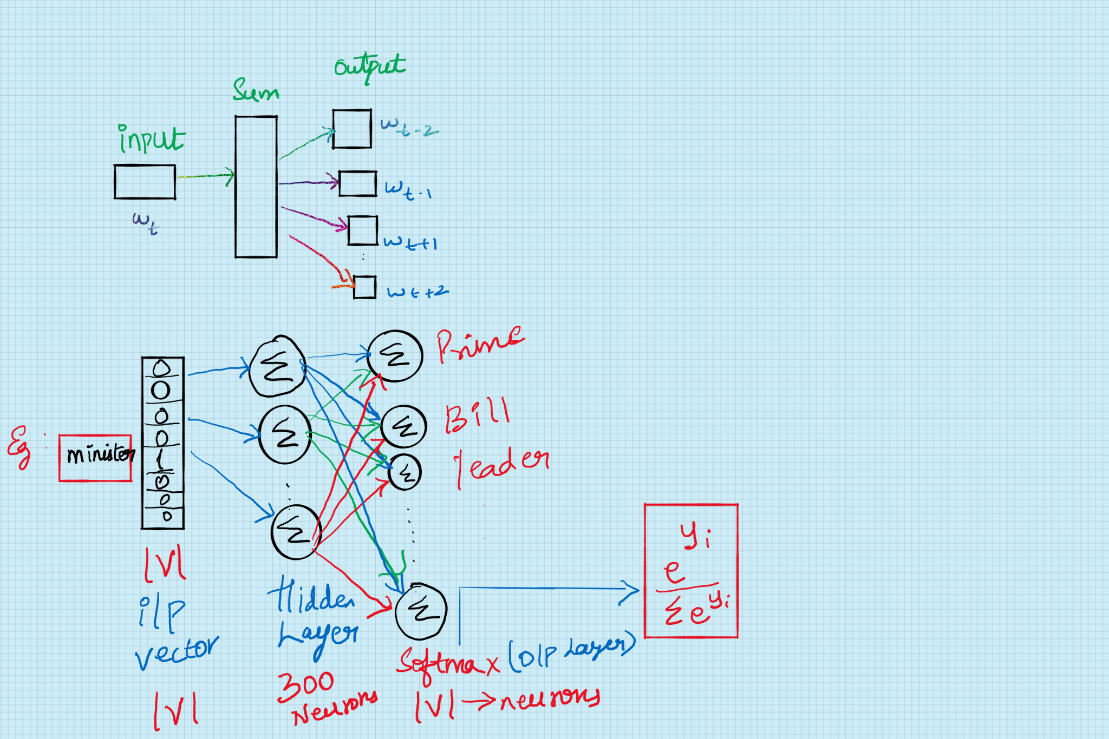
Computation

Slide 7
Avoiding Softmax
Why? - Because it is computationally expensive
How to avoid it?
Hierarchical Softmax
Noise Contrastive Estimation
Negative Sampling
Subsampling

Slide 8
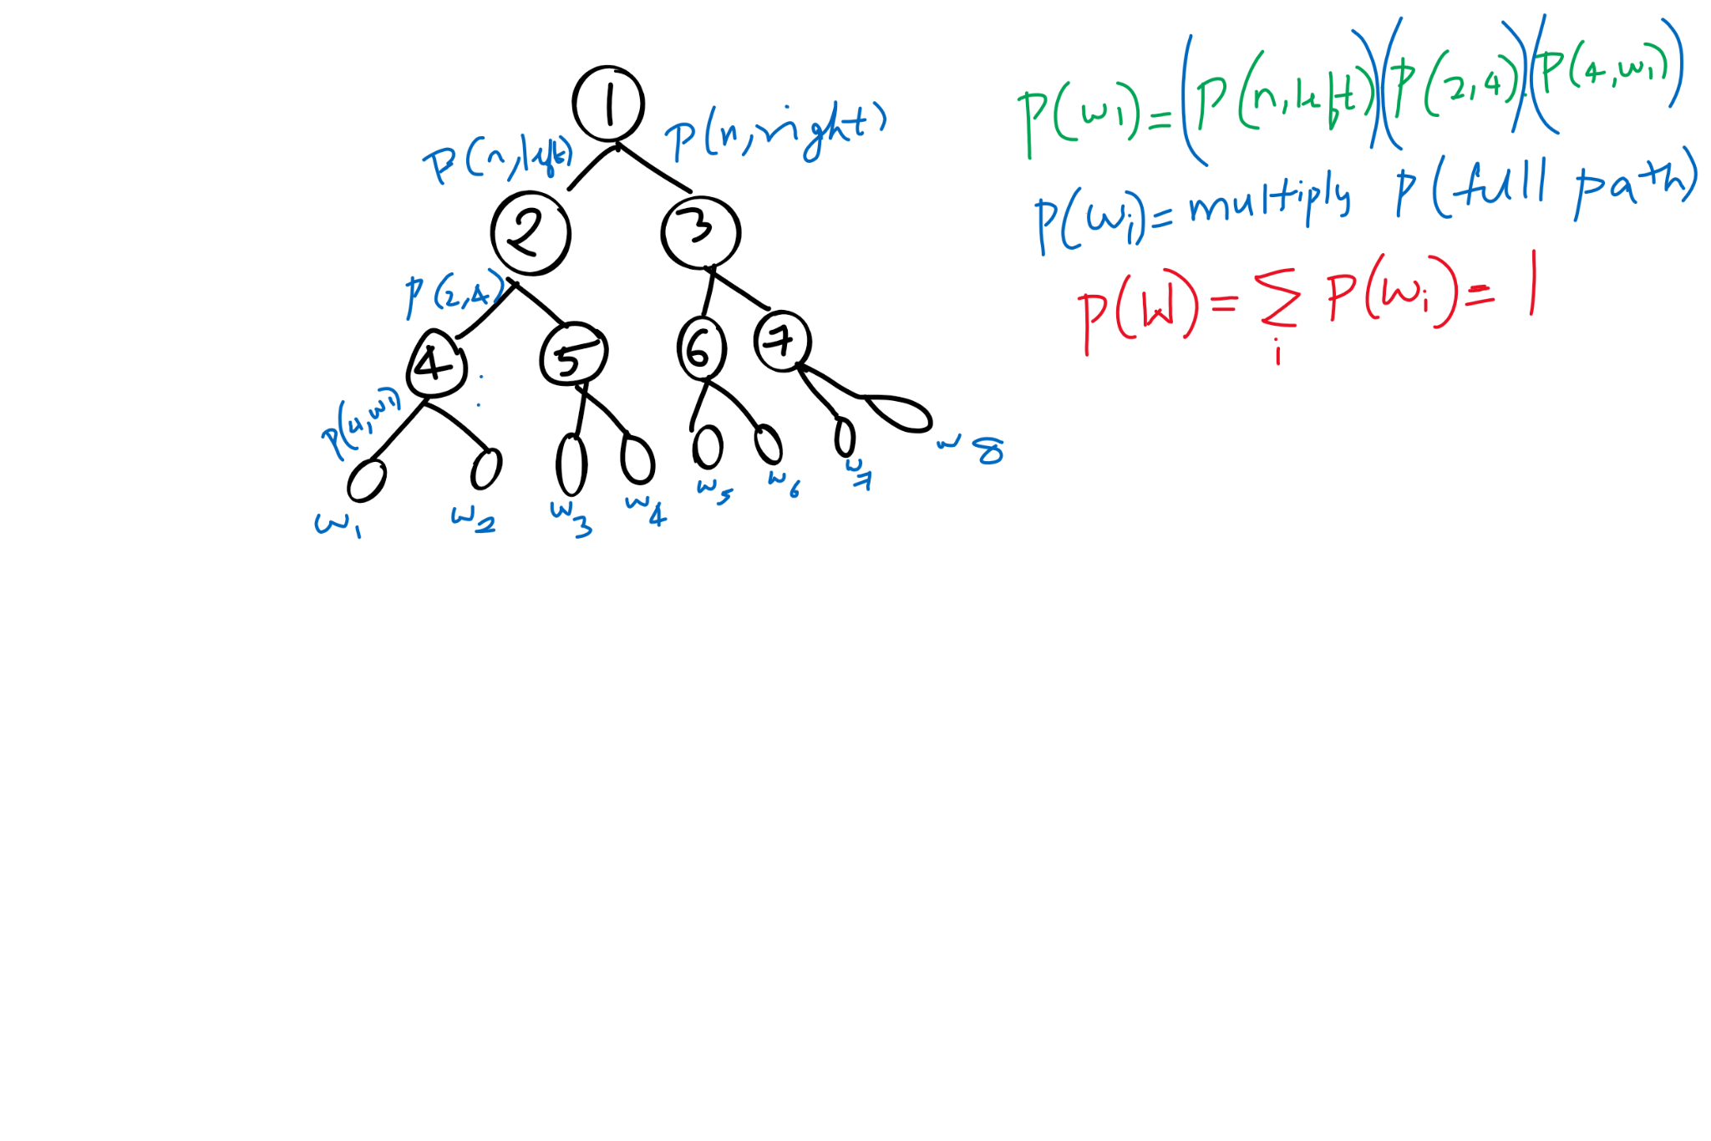
Hierarchical Softmax

Slide 9
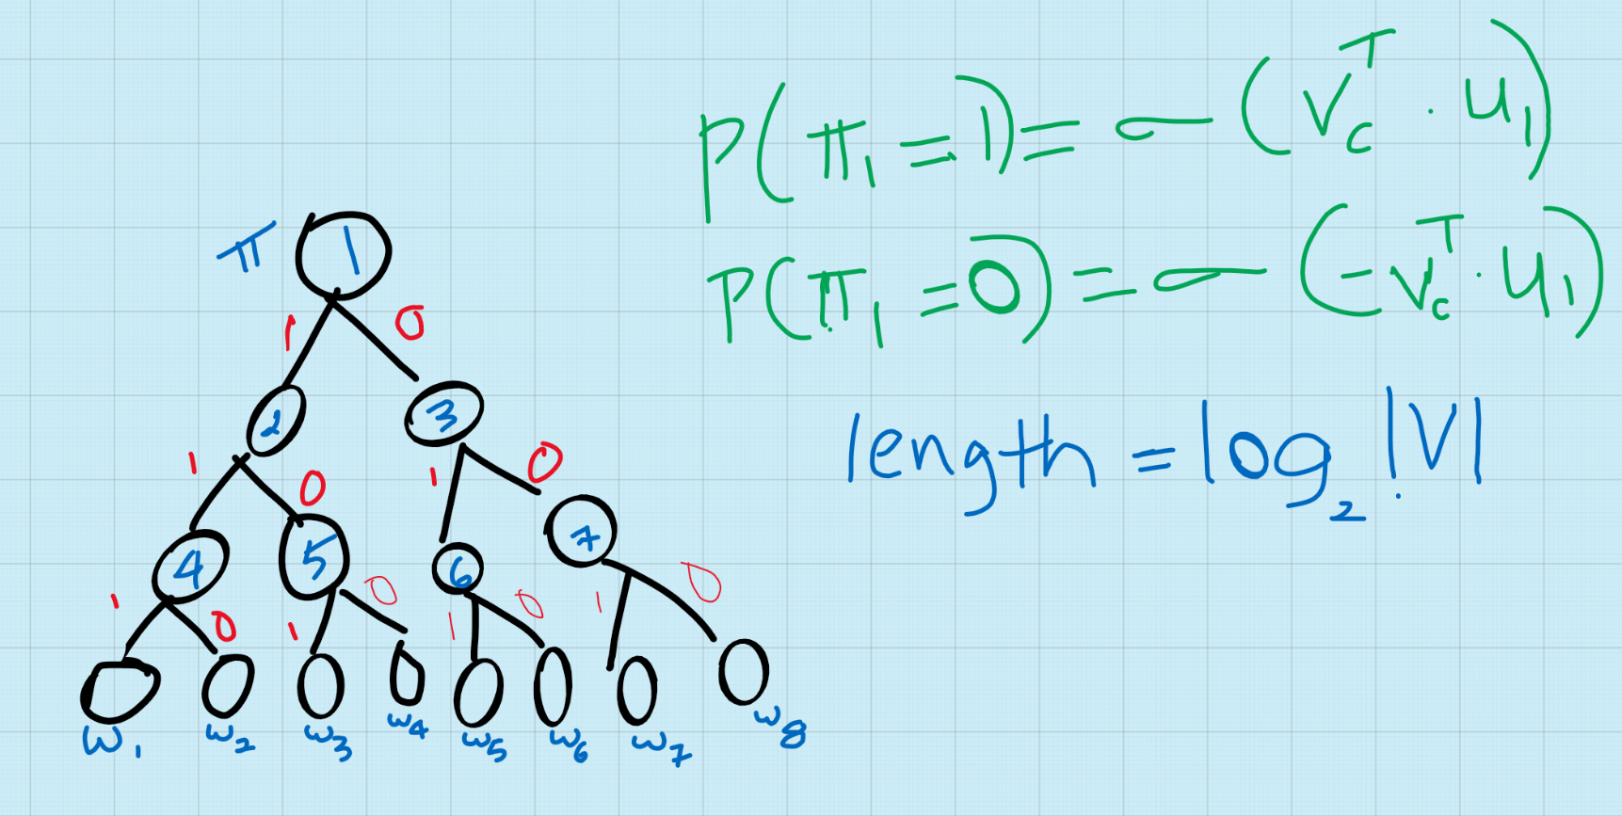
Hierarchical Softmax

Slide 10
Hierarchical Softmax
Converts full layer(size of |V| to log |V|
Unique path available to each word
By using Huffman Trees : 1) Saves storage space
2) Generates shorter code for more frequently occurring words

Slide 11
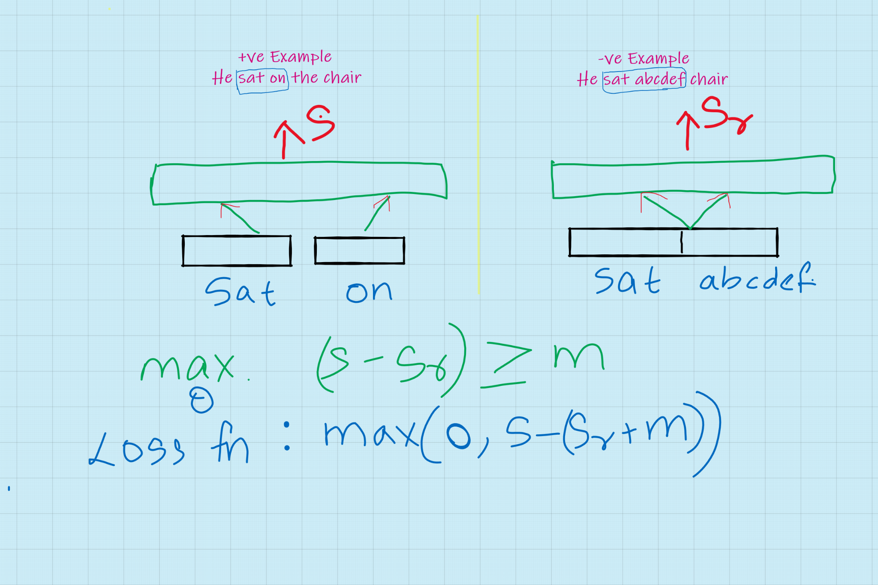
Noise Contrast Estimation

Slide 12
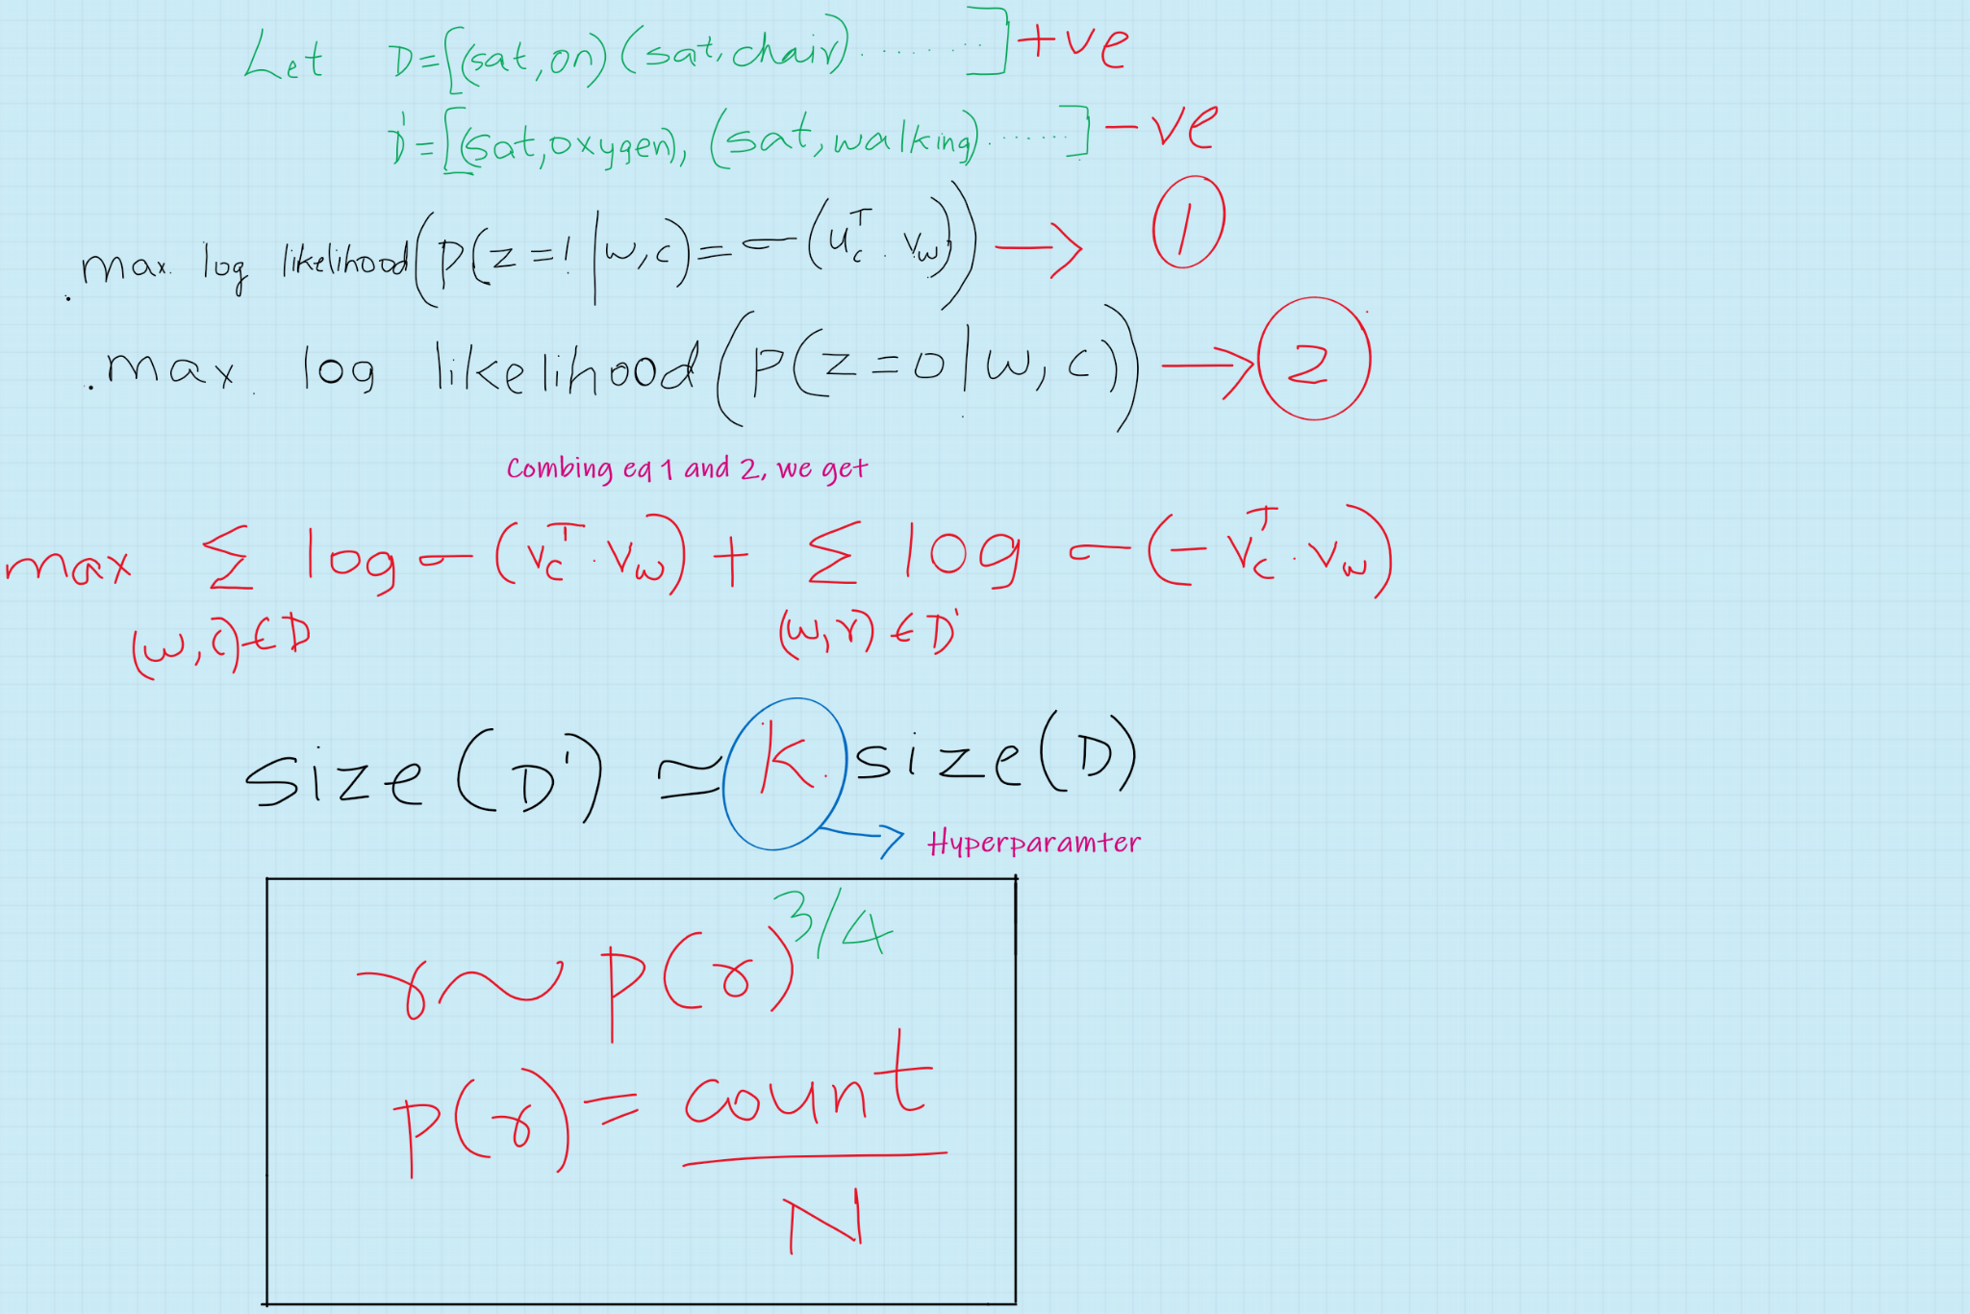
Negative Sampling

Slide 13
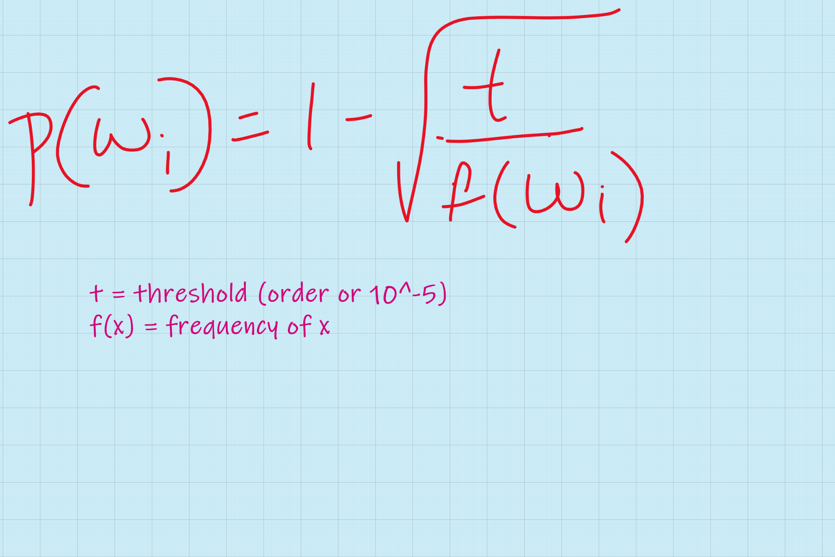
Subsampling
Very frequently occurring words provide less information value than less frequently occurring words
Also, Least frequently occurring words(Eg: only 1 time occurrence) may not necessarily provide information of much value
To counter the imbalance, the training set is discarded with probability computed by,
This subsampling accelerates learning speed, also improves accuracy(Empirical observations)

Slide 14
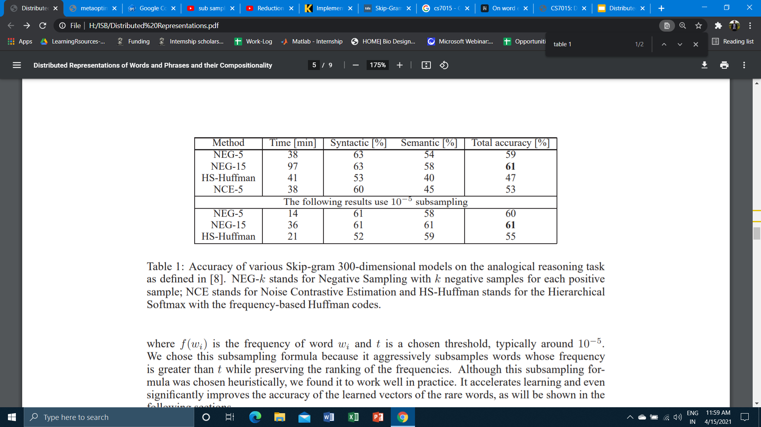
Results

Slide 15
